Slide 1
Energy efficiency in the global energy transition: How rural communities can equitably transform their energy systems
Elizabeth Doris
National Renewable Energy Laboratory
Notes:
If we can work shoulder to shoulder with enough communities to deploy and demonstrate clean energy technology in a way that makes sense for the whole of the local context, we can accelerate clean energy at a scale that matters locally and contributes to meeting national goals.

Slide 2
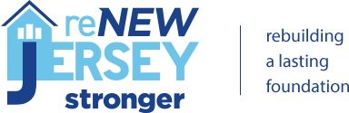




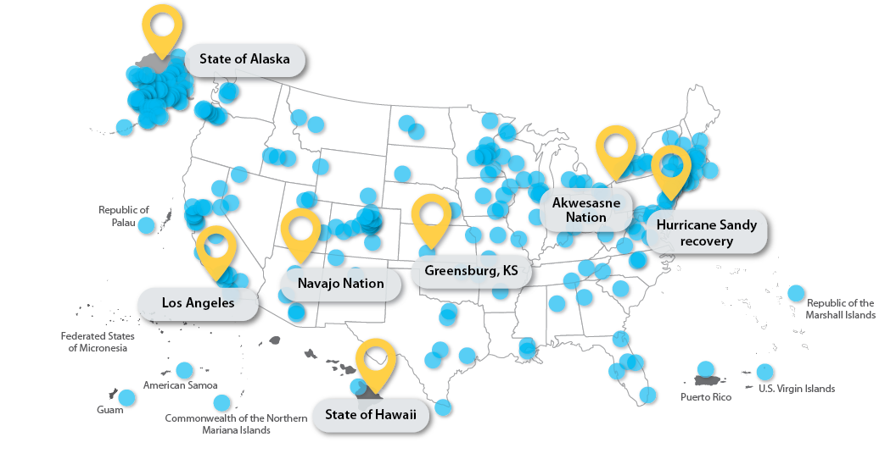























NREL’s decades of experience span a variety of sponsors and
over 2,000 communities, utilities, and businesses.
Notes:
One of the reasons we were able to do that is because of our massive depth of experience in the area of working with communities and on the ground stakeholders to integrate technologies in a culturally appropriate and responsive way.
We’ve worked with 1000s of communities and on the ground partners to help them understand their technology, market, and policy options within the confines of their goals. I already mentioned our integration with CCHRC, and in addition to that, our project work spans from small, often overlooked and remote communities to major cities like LA. If the goal is transforming energy, nobody is forgotten.

Slide 3
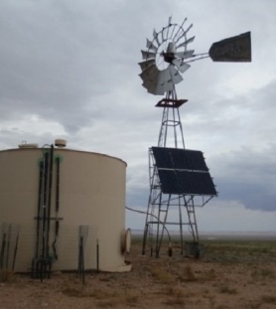
Energy Transition considerations by Community context
Cultural
Clean energy resources
Energy governance
Logistical
Financial

Slide 4
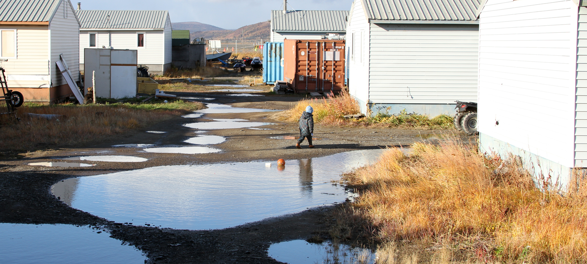
Energy Efficiency Benefits Disproportionate in Rural and Arctic context
Life safety
Reduced community cost/access risk
System flexibility
Comfort and indoor air quality safety
Reduced individual cost / volatility
Grid flexibility
Notes:
When technologists thing about the benefits – there is a shift in what those are because they are community based instead of individual based.

Slide 5
Connectedness of Systems
Safety and Security
Health and Medical
Communications
Hazardous Materials
Food, Water, Sheltering
Energy (Power & Fuel)
Transportation
https://www.fema.gov/emergency-managers/practitioners/lifelines
Notes:
Moreover, they are connected – os you need an even broader look. When I talk to our technologists about this they are basically like, ‘so I have to be everything to everyone now?’ and I sort of laugh and say, ‘yeah – welcome to life in a rural environment – everything to everyone.’ good news though – you aren’t alone – and you should never do it along

Slide 6
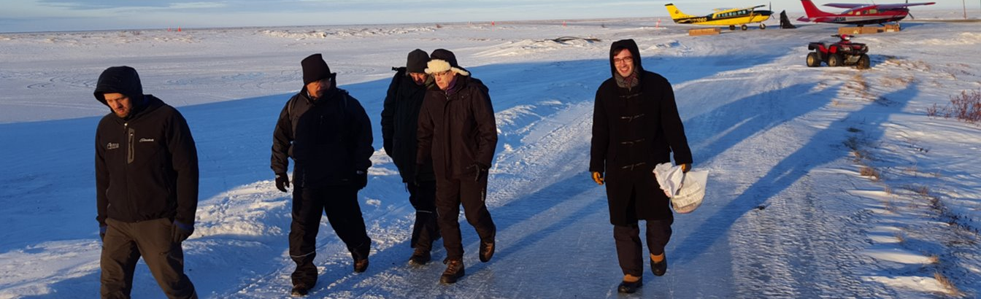
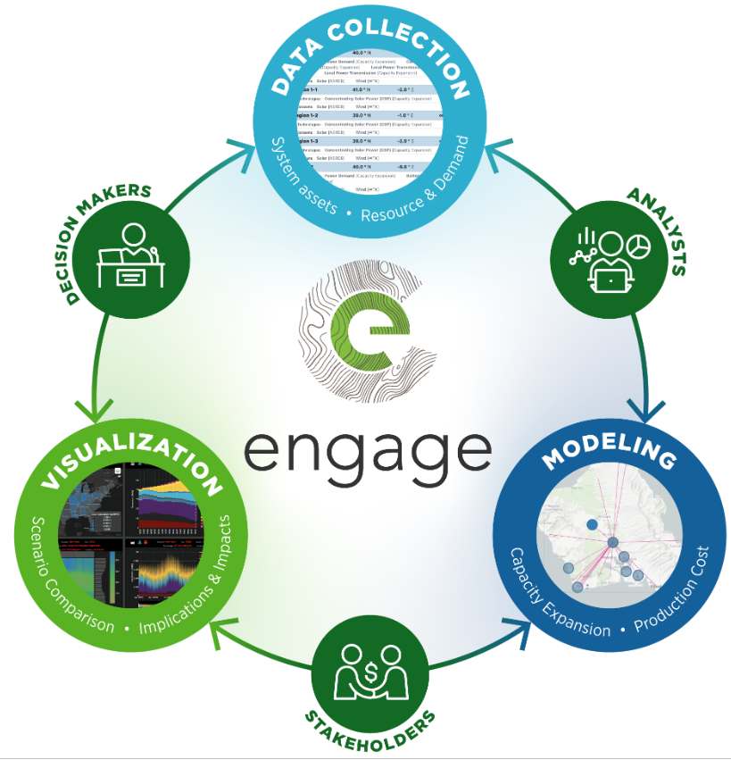
Valuing local and technical expertise

Slide 7
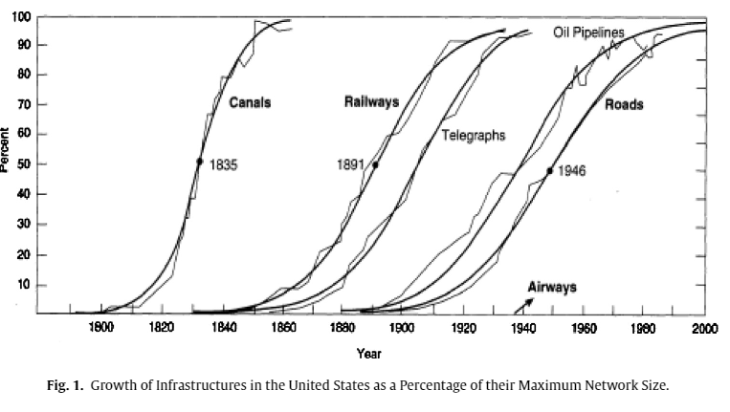
It’s a long game
B.K. Sovacool / Energy Research & Social Science 13 (2016) 202–215
From: Grubler Arnulf and Nebojsa Nakicenovic Review, 14 (2) (1991), pp. 313-342 (Spring)

Slide 8
Energy Efficiency Transition in Rural Environments
Different higher stakes, benefits of technologies
Consideration of local interconnected systems
Expanding stakeholders locally
Long game for transition

Slide 9
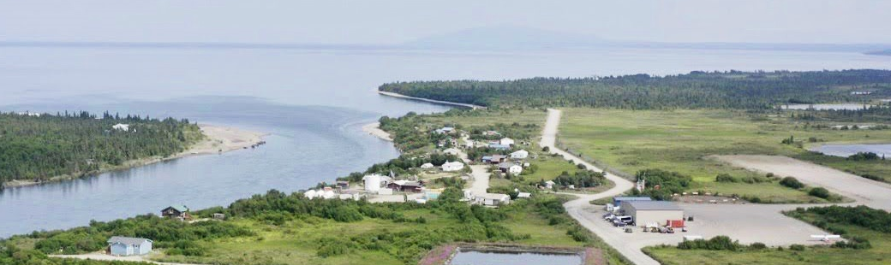







Readily scalable program with vulnerable communities
Community priorities
Partnership
approach
Energy assessment and planning
Resilient energy systems
Remote, island, and islanded community energy and infrastructure challenges, values, and goals
Deep energy-sector experience, expertise of the national labs + local, trusted stakeholder organizations
Provide resources and on-the-ground support
Knowledge sharing →
lessons learned, use cases → identified responsive technology needs
OFFICE OF STRATEGIC PROGRAMS | SOLAR ENERGY TECHNOLOGIES OFFICE | WATER POWER TECHNOLOGIES OFFICE | OFFICE OF ELECTRICITY
Notes:
We’ve been working multiple place based pathways to scale more effectively. We are really proud to be DOE’s core lab in implementation of the ETI Partnership Program – ETIPP. ETIPP is a consortium - a platform where programs can invest to get their deployment priorities met while meeting communities where they are and not having a proliferation of different programs that can be disproportionally challenging to access by underserved communities.
Photo courtesy DOE

Slide 10
Thank you! Questions?
Elizabeth.Doris@nrel.gov

