Slide 1
National Inter-Tribal Energy Council
Equitable energy transition for Native American tribes and Alaskan Native Villages
Arctic Sustainable Energy Research Conference
Chris Deschene
Board Member, NITEC
April 20, 2021

Slide 2
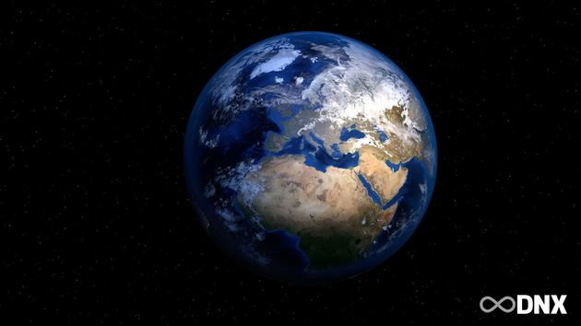
Our World is Changing.
Land
Natural Resources
Wealth & Poverty
Education
Politics
Technology
Climate Change
Covid19

Slide 3
Nexus between Climate Change, Resulting State & Federal Polices and Climate & Energy Equity
Tribe/Village
Natural Resources
Economy & Infrastructure
Politics & Government
Technology & Innovation

Slide 4
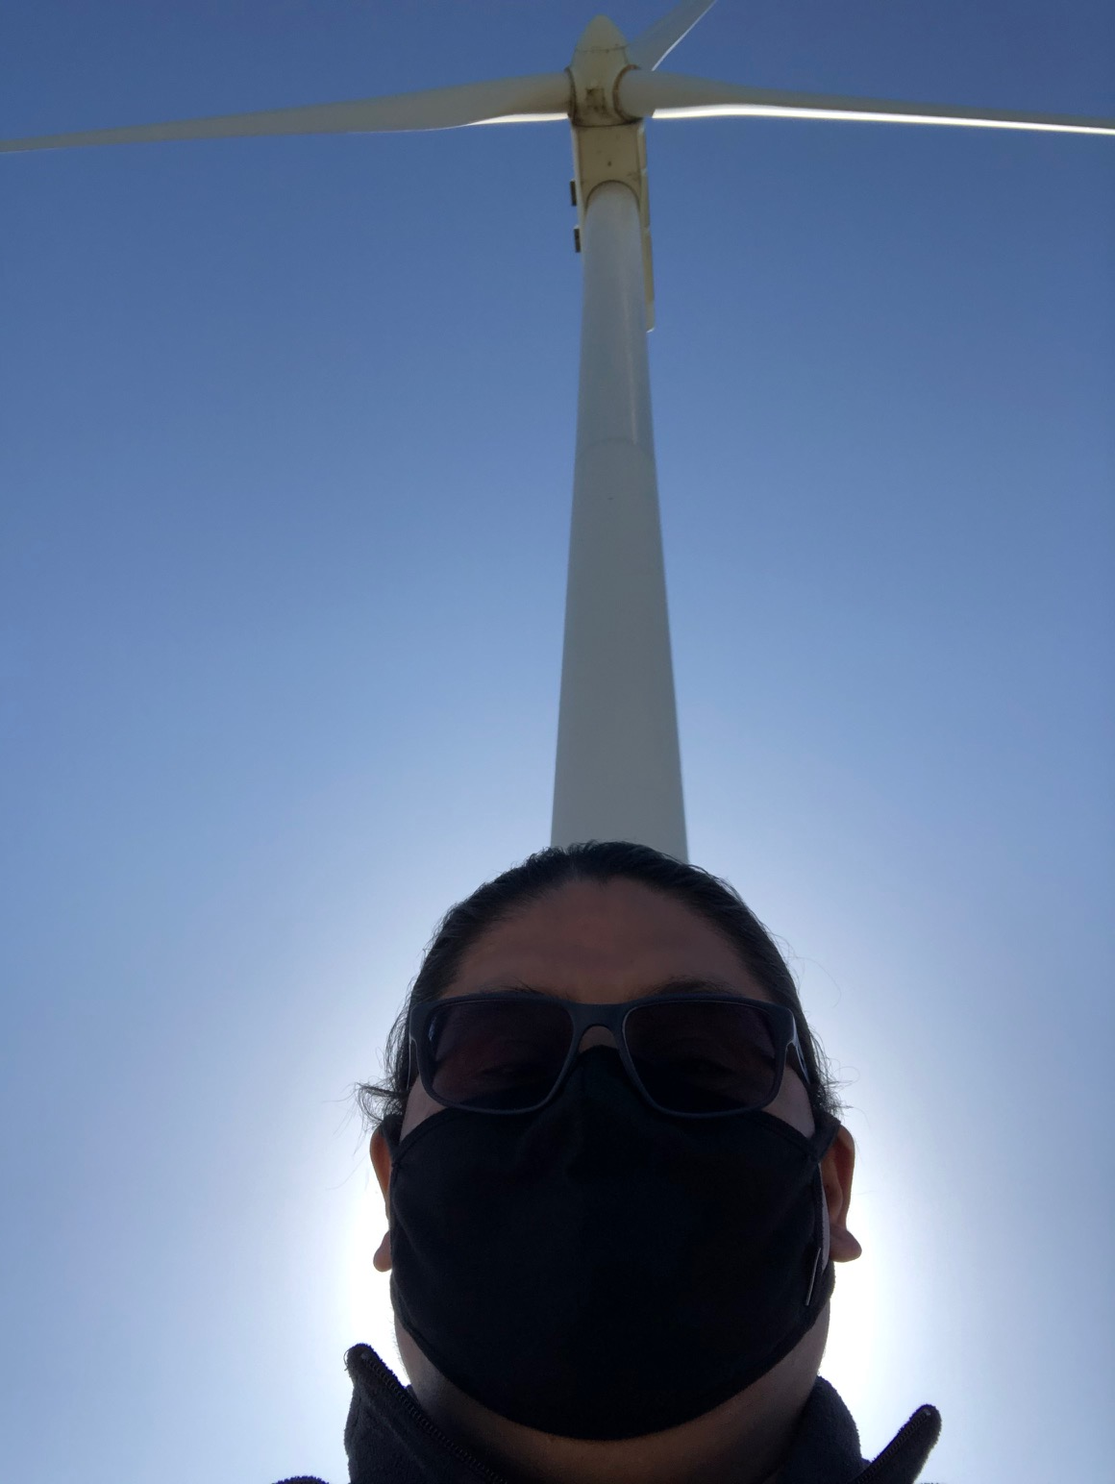
What is needed to ensure an equitable energy transition?
Identifying threats, challenges, barriers to tribal communities
Climate & renewable energy threat assessment
Ensure inclusive governance of energy transitions
Consultation & Decision-Making
Policy & legislative development
Ensure equity and ownership
Constant education of new leadership
“Educate Them All”
Secure financial resources to compete
Number #1 policy priority

Slide 5
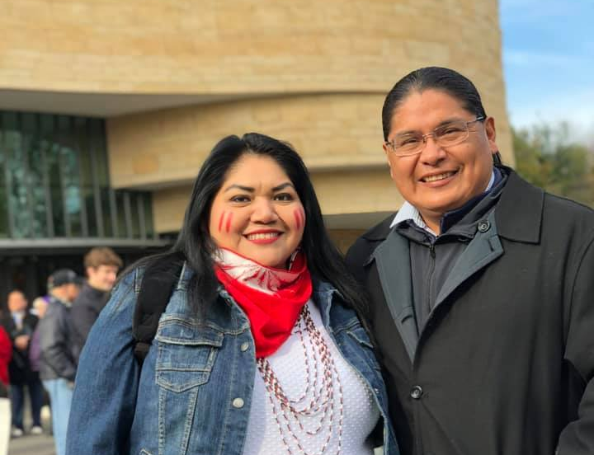
How Native American and Alaska Native communities play an important role in energy development:
Organize for Change
Build Strategic Relationships
Develop Strategic Plans
Acquire Financial Resources
Recruit Fearless Leadership
Innovate

Slide 6
Plan: A common basis for change.
Leadership
Make a Plan
Implement the Plan
Review the Plan
Revise the Plan

Slide 7
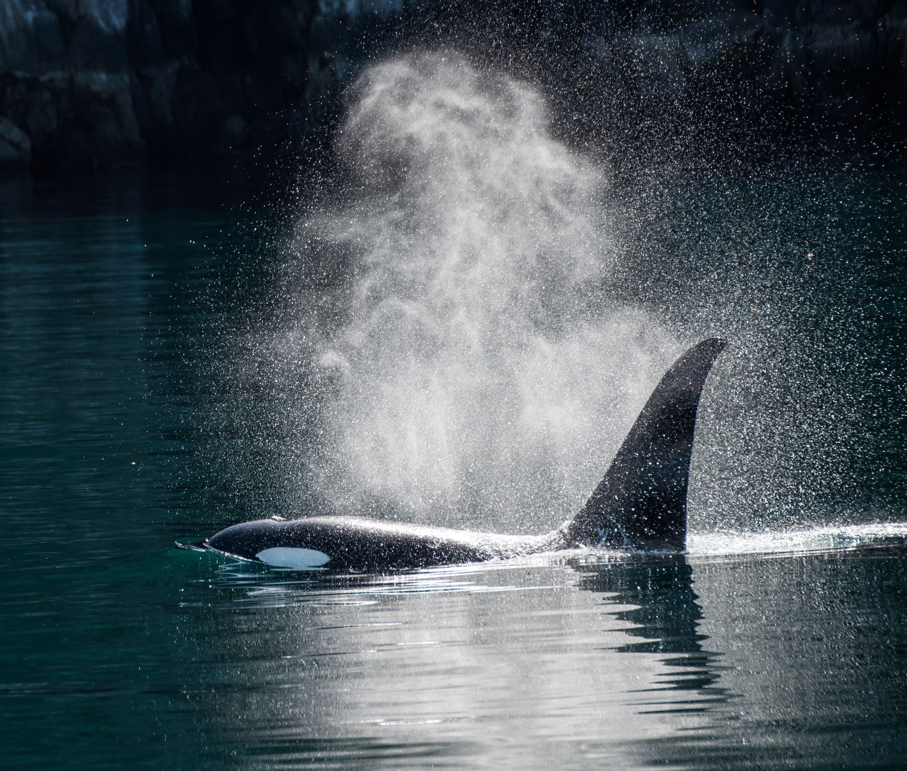
Results within Alaska & Indian Country
Securing investment, development and equity capital for tribal energy development on tribal and native village lands.
Creating ownership and equity opportunities for tribes and native villages.
Promoting and supporting innovative technology applications for energy projects on native village and tribal lands.
Advocacy and tracking of 2021 federal, state and tribal energy legislation and policies.
Reducing regulatory burdens:
Streamlining NEPA processes for tribal energy projects on tribal lands.
Obtaining ROW authority and regulatory oversight for energy projects on tribal lands.
Defining workable solutions to existing barriers within tribal, public, co-op and private utility jurisdictions operating on tribal lands.
Leveling the tax playing field for energy projects on native villages and tribal lands between federal, state and tribal jurisdictions.

Slide 8
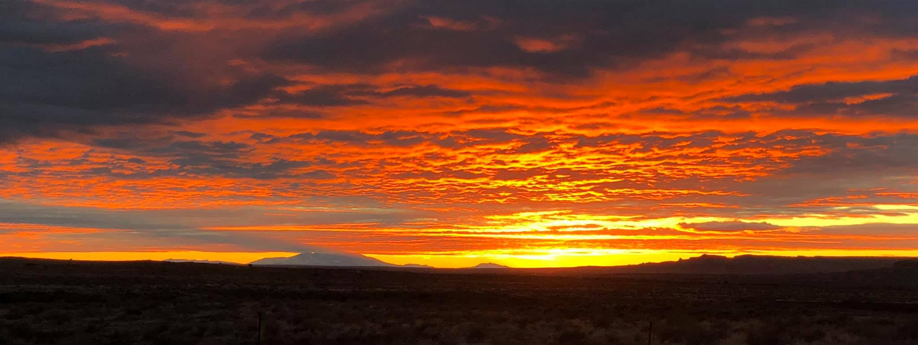
Thank you!
Chris Deschene
National Inter-Tribal Energy Council
480-544-7381
chris.deschene@itenergy.org

