Slide 1
Arctic Sustainable Energy Research Conference: Supporting the Transition of Remote and Indigenous Communities to a Clean Energy Future
Meaghan Bennett, Natural Resources Canada
April 22nd, 2021

Slide 2
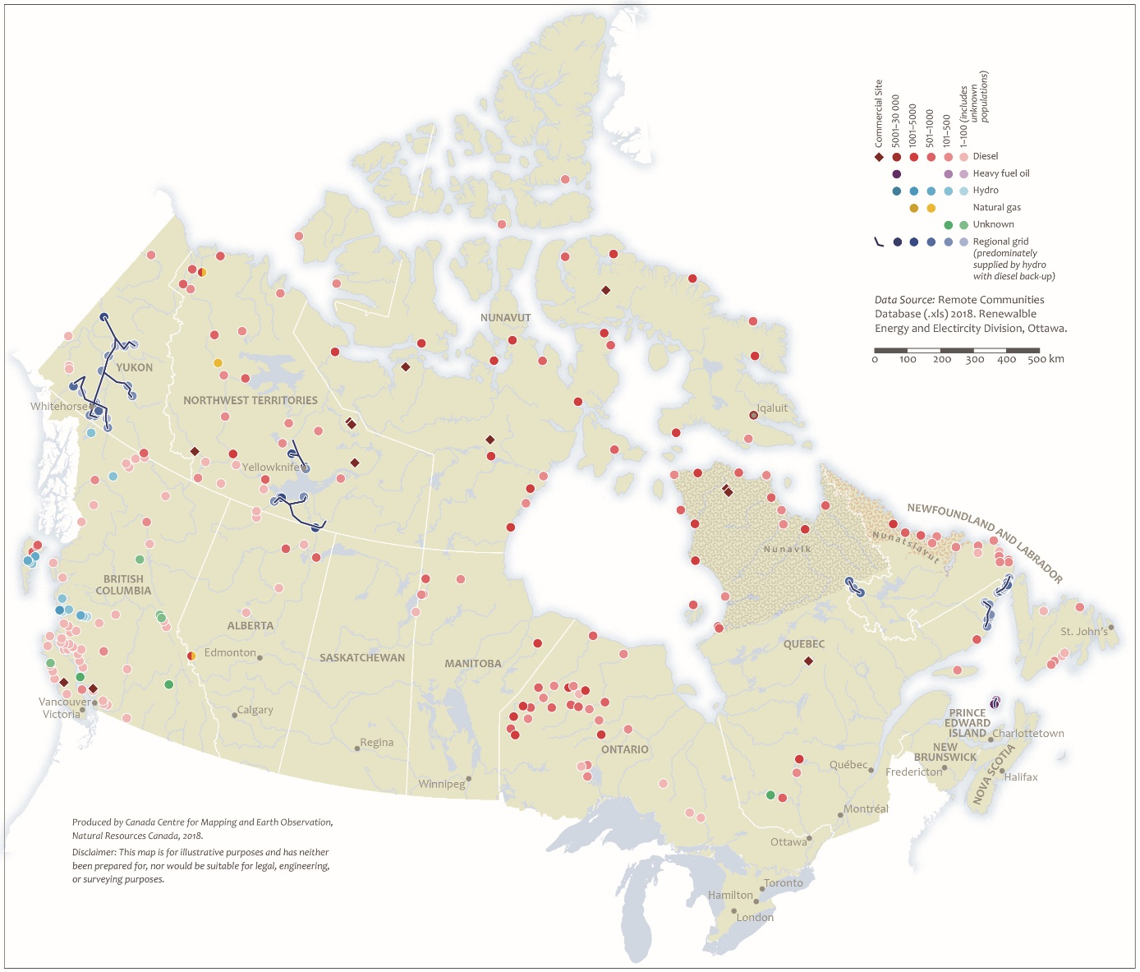
Diesel Reliance in Remote Communities in Canada
~200 communities reliant on diesel for heat and power (~70% Indigenous).
Communities are geographically dispersed, with varying needs and resources, no one size fits all solution.
The Government of Canada has committed to support the transition of Indigenous communities from reliance on diesel to clean, renewable and reliable energy by 2030.

Slide 3
Supporting remote communities reduce their reliance on diesel fuel is an important federal priority & commitment
…to renewable energy, energy efficiency and conservation
Moving from diesel fuel…
Reconciliation
Sourced outside the community
GHG emissions
Spills, local pollution & contaminated sites
Costly to supply and maintain
Aging infrastructure and breakdowns
Harness local resources
Improve health & environmental outcomes
Create local economic opportunities
Build local capacity and knowledge
Support energy independence
Climate Change
Economic Growth
Health & Well-Being

Slide 4
Program Design and Priorities
Support the transition of Indigenous and remote communities from reliance on diesel to clean, renewable and reliable energy
NRCan programs/activities: Clean Energy in Rural and Remote Communities program, Indigenous Off-Diesel Initiative, R&D led by CanmetENERGY
Indigenous and Community led projects: increasing self-determination & focus on supporting local expertise building
Support can look like:
Resources (e.g. funding for salary or training)
Technical review for project proposals & plans
Community, regional, & national level training and networking
Mentors
Tailored clean energy training

Slide 5
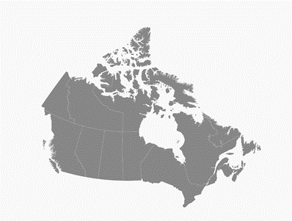
Case Study: Indigenous Off-Diesel Initiative
$20M over 4 years
14 Indigenous Clean Energy Champions in remote communities:
Tailored clean energy training
Mentors
Peer-to-peer network
Resources
Indigenous Jury
Working with partners and collaborators

Slide 6
Case Study: Indigenous Off-Diesel Initiative A multi-phase approach
Launch
Phase 1
Phase 2
Phase 3
Phase 4
Feb-Mar 2019
May-July 2019
Oct 2019-March 2022
Octo 2020-Feb 2023
Mar 2023-Mar 2026
Participate in 20/20 Catalysts Program
Project Design and Development
Additional Project funds
Call for Clean Energy Champions and an Indigenous Jury
Develop Community Clean Energy Plan
$20K funding and $25K in-kind support
$500K
$800k grant
$9M available in follow-on funding
Getting Ready
Learn + Network
Get Planning
Develop and Implement Project Idea
Project Construction

Slide 7
Case Study: Clean Energy for Rural and Remote Communities Program (CERRC)
Program Objective: promote a transition to a more sustainable and clean energy future by supporting projects that reduce reliance on diesel in Canada’s rural and remote communities and industrial sites.
Funding
$220M over eight years (2018-2026) to support renewable energy and capacity building projects.
Streams
BioHeat - $55M
Demonstration – $60M
Deployment – $90M
Capacity Building – $10M
Focus
Innovative demonstrations
Renewable energy for power and heat
Skills development
Program website:
http://www.nrcan.gc.ca/energy/science/programs-funding/19791

Slide 8
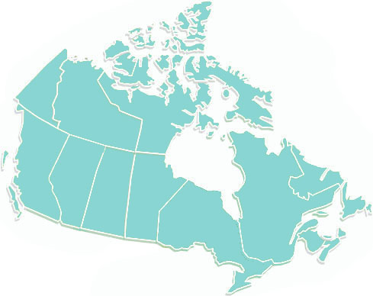
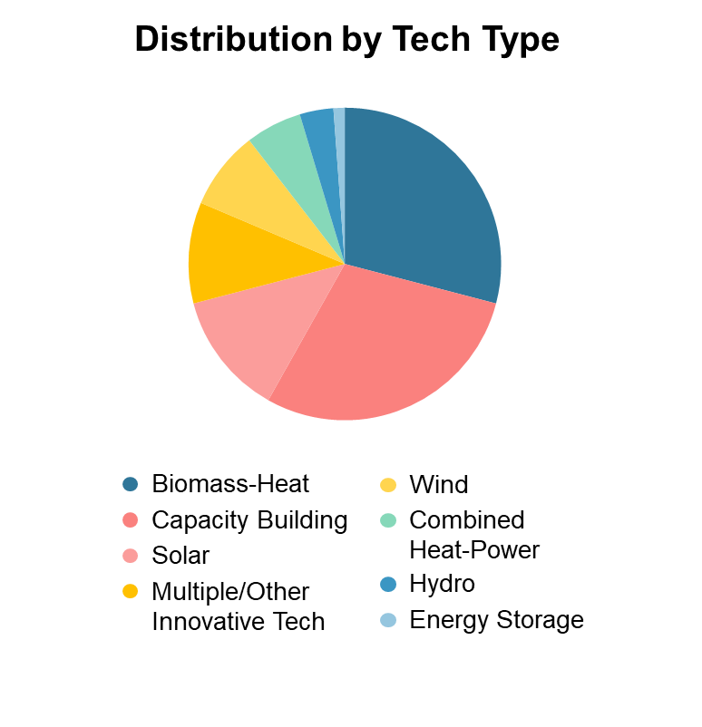
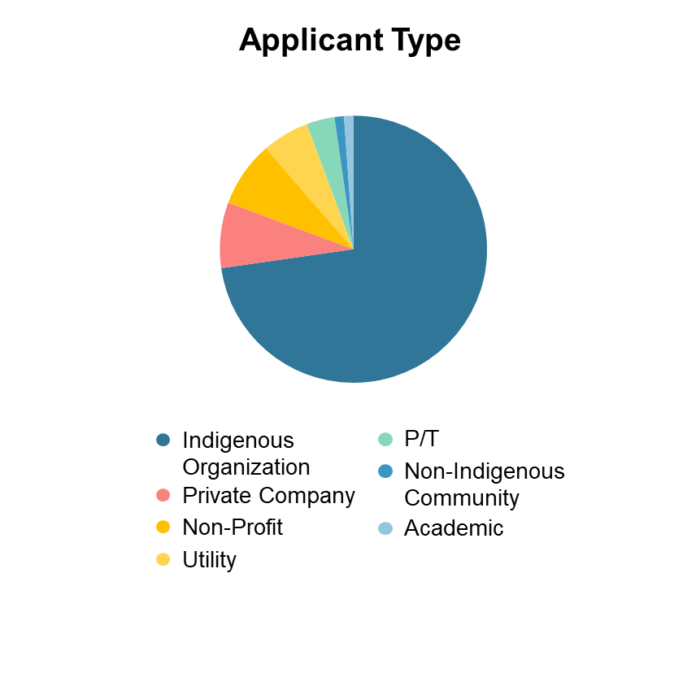
Case Study: Clean Energy for Rural and Remote Communities Program (CERRC)
2
8
9
6
3
3
4
21
2
3
1
17
4
1

Slide 9
CanmetENERGY – National Energy Labs
ReCREAT: renewable energy modelling tool to support communities decision making
Northern Housing: research to support more resilient, energy efficient and affordable housing
Wind, Solar, Storage & Microgrid technologies: Technology-neutral analysis and modelling to support communities

Slide 10
Lessons Learned & Looking Forward
Importance of Indigenous & community led projects
Inclusive & accessible funding with flexibilities
Longer timelines for projects
Early & on-going engagement and prioritization of co-development
Relationship focus & continual learning
Additional $300M announced in December 2020

Slide 11
Questions?
Contact: Meaghan Bennett: meaghan.bennett@canada.ca

