Slide 1
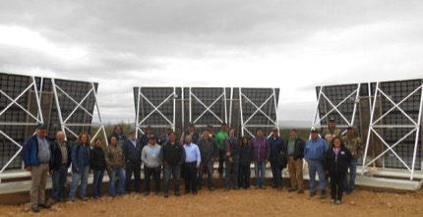
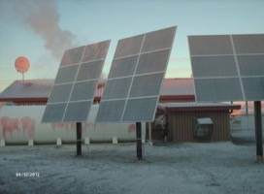
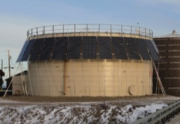
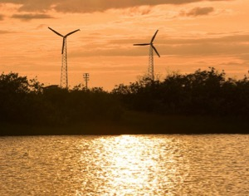
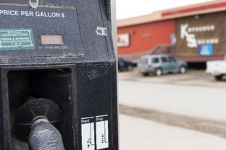
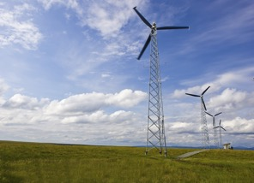
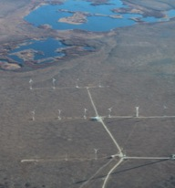
Village Economic Development
Arctic Sustainable Energy Research Conference –
Alaska Energy and Climate Equity –
Regional Needs Informing Energy Policy
Sonny Adams – NANA Regional Corporation; Brian Hirsch – DeerStone Consulting
April 20, 2021 • Anchorage, Alaska
Notes:
Good morning, my name is Sonny Adams, I’m the Director of Alternative Energy for NANA Regional Corporation. Today I’ll give a brief update on our energy projects, along with some of the challenges we’re having in building Arctic microgrids.

Slide 2
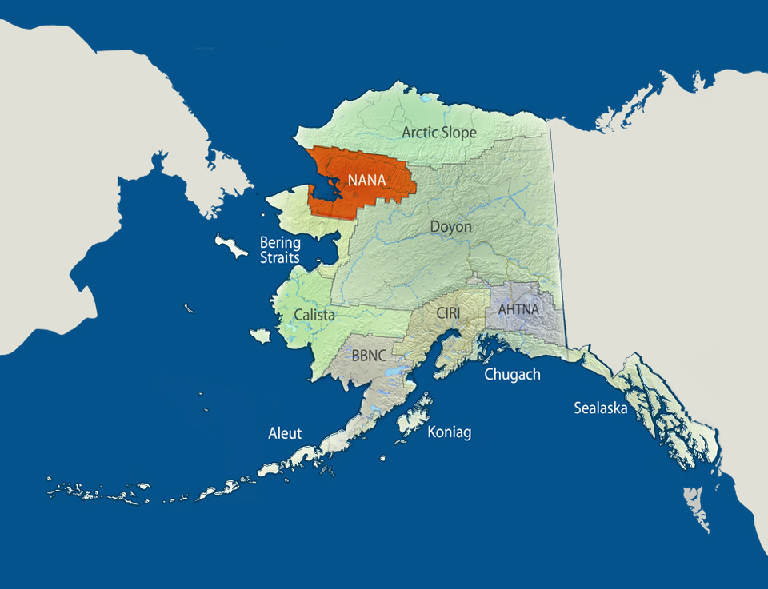
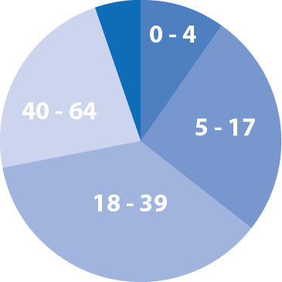
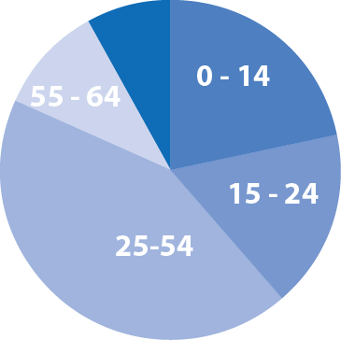
Who We Are
ANCSA – Alaska Native Claims Settlement Act
NANA Region Age Distribution
NANA received 2.2 million acres and
$44 million in cash
Notes:
• On Dec. 18th, 1971, President Nixon signed ANCSA settling the land claims issue by transferring land titles to twelve Alaska Native Corporation and over 200 local village corporations. Alaska Natives received compensation in order of approximately $962.5 Million and fee simple title to 44 million acres of surface and subsurface estate. That equaled 1/10th of Alaska.
• As a result of ANCSA, NANA Regional Corporation received 2.2 million acres of land and $44 million in cash.

Slide 3
NANA REGION Introduction
Notes:
This map shows the outline of our region. Our region is approximately 38,000 square miles, it’s about the size of Indiana. We have approximately 14,000 shareholders, half of which live in the region. Although not shown here, our region has the second largest zinc producing mine in the world, called the Red Dog Mine.

Slide 4
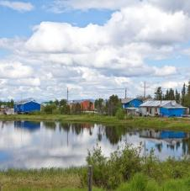
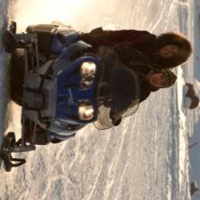
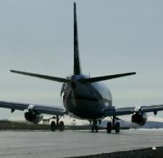
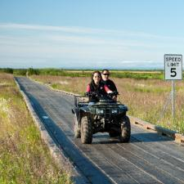
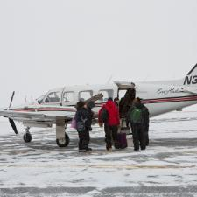
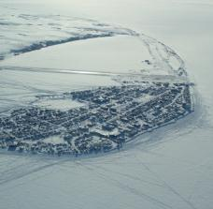
A Remote Region
No roads connect communities
61 % more expensive than Anchorage
High cost goods and fuel
Diesel Dependence = Energy Insecure
Notes:
People in our region are not connected by roads like those living on Alaska’s rail belt.
The remote nature of our region makes it 61 percent more expensive to live in than Anchorage.
The remote nature of the region creates makes the cost of living very high and creates substantial barriers to developing a vibrant and thriving regional economy.

Slide 5
NANA Region Energy Projects
NANA’s Energy Vision
The energy vision for the NANA Region is to be 50 percent reliant on alternative energy sources, both renewable and non-renewable.
10 percent decrease of imported diesel fuels by 2020
We are on-track to meet this goal, in part thanks to DOE and significant community effort
25 percent decrease of imported diesel fuels by 2030
50 percent decrease of imported diesel fuels by 2050

Slide 6
NANA’s Village Energy Program History
Notes:
Looking back on how we got started. We received a DOE Strategic Energy Plan grant and that led to the creation of our Regional Energy Plan. We also formed the Energy Steering Committee, which is still in existence today. We also performed an Energy Option Analysis for each of our villages. This was followed by an Energy Summit in Kotzebue, along with a Regional Energy Survey.
Looking back on how we got started. We received a DOE Strategic Energy Plan grant and that led to the creation of our Regional Energy Plan. We also formed the Energy Steering Committee, which is still in existence today. We also performed an Energy Option Analysis for each of our villages. This was followed by an Energy Summit in Kotzebue, along with a Regional Energy Survey.
2007 DOE IE Grants – NANA Strategic Energy Plan (SEP), NANA Wind Resource Assessment Plan (WRAP), NANA Geothermal Assessment Plan (GAP)
NANA Strategic Energy Plan (SEP) - Lead to formation of the Energy Steering Committee (ESC), Regional Energy Plan, Energy Option Analysis, 2009 Energy Summit in Kotzebue, Energy Survey
NANA Wind Resource Assessment Plan (WRAP) – Wind data collection lead to the Northwest Arctic Borough (NWAB) installing wind turbines in Deering and Buckland. Wind turbines funded by the State of Alaska (for Deering and Buckland).
NANA Geothermal Assessment Plan (GAP) – Report completed. Heat resource too far from the villages. (Cost of transmission line)

Slide 7
Importance of Renewable Energy
WHY ARE WE DOING THIS??? 2020 ENERGY PRICES IN… | Gas/G | Stove Oil/G | Kwh (1-500) PCE | Kwh (>501) NO PCE
Kotzebue | $5.88 | $5.92 | $0.19 | $0.41
Ambler | $10.30 | $10.30 | $0.23 | $0.64
Kobuk | $9.27 | $9.27 | $0.23 | $0.70
Shungnak | $8.50 | $8.50 | $0.23 | $0.70
Kiana | $5.15 | $5.67 | $0.22 | $0.54
Noorvik | $6.06 | $5.64 | $0.22 | $0.56
Selawik | $5.30 | $6.36 | $0.22 | $0.54
Buckland | $6.15 | $6.15 | $0.26 | $0.47
Deering | $3.35 | $3.35 | $0.39 | $0.67
Kivalina | $5.10 | $4.53 | $0.22 | $0.52
Noatak | $9.26 | $9.26 | $0.21 | $0.91
Current NANA Region Fuel Prices and Electric rates
Notes:
So why are we doing this? Reason being is our energy prices continue to remain high throughout our region. As you could see from the two left columns our gasoline and diesel fuel prices range from $3.35 to $10.04 per gallon. For our region, we use diesel fuel for electricity generation and home heating.
The two columns on the right, show our electrical rates. The lower electrical rate on the left is our state subsidized rate called Power Cost Equalization otherwise known as the PCE rate. The column all the way to the right shows the actual rate without power cost equalization. So there’s incentive to keep your electrical usage under 500 kilowatt-hours.

Slide 8
Regional Energy Costs in 2019
Power Generation Fuel Costs $12,766,366
AVEC Utilities $5,284,984
Independent Utilities $7,481,381
Heating Fuel Costs $23,213,120
NWAB School District $3,058,900
All other customers $20,154,220

Slide 9
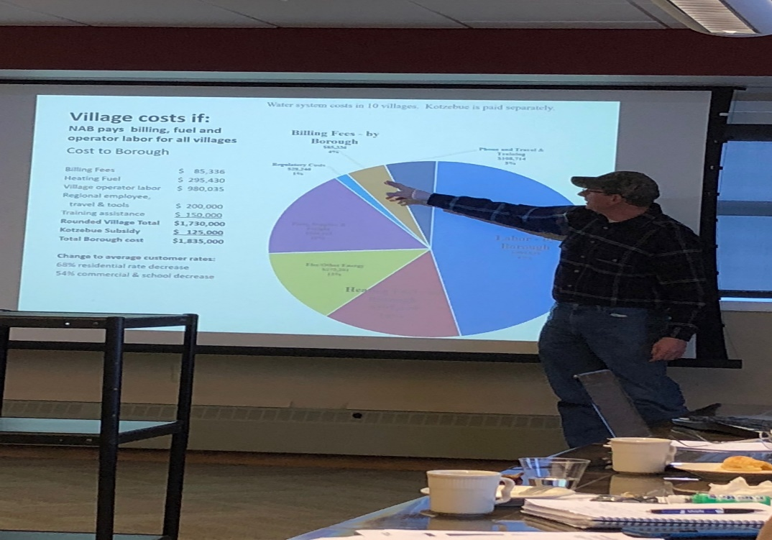
DOE Inter-Tribal Technical Assistance Grant
Department of Energy has awarded NANA $495,460 to create an Inter-Tribal Network in the Northwest Arctic
5-year effort (began in October 2016); ending in Sept 2021
Local capacity building and economic development
Regional Coordination for all 11 communities
Other AK Regionals also received grant (with potential for cross regional collaboration), including in Bering Strait & Calista regions, attendance at ESC meetings in Kotzebue
Notes:
But before make the transition, we needed to create an Inter-Tribal Network to build local capacity and promote economic development. An organization where we can talk about our energy challenges, and move towards regional solutions.

Slide 10
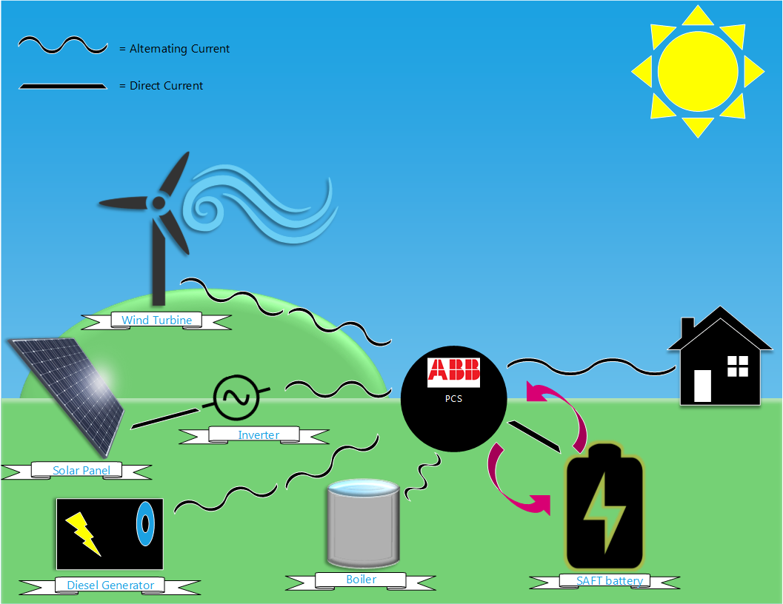
APPLIED ARCTIC TECHNOLOGY
BASIC MICRO-GRID
Notes:
One of main goals is to make the transition from the traditional power grid to the modern micro-grid. In the summer, when there’s plenty of wind and solar, that’s when we want to demonstrate diesel-generator off technology and run totally on renewable energy. This drawing shows all the different components for the modern microgrid.
If we can get to low-cost electricity, we could heat the home with heat pumps using low-cost electricity, rather than expensive diesel fuel.

Slide 11
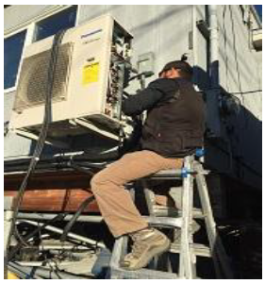
ESC Priorities → Action Plan
Critical path to Village Economic Development: Roads and Interties
Business Case for High Penetration Renewable Energy (must include heat)
Lower/stabilize energy costs! (Regional cooperation, new technologies, efficiencies, business structures, financing and grants, economies of scale)
Powerhouse Upgrades to Integrate Renewables
Workforce Development - Utility management, Powerhouse operators/mechanics
Renewable Energy training – wind technicians, solar technicians, energy storage battery maintenance, heat pumps
Notes:
These are the ESC priorities that we are moving to the action plan.

Slide 12
Accomplishments
Community Meetings:
Shungnak
Kobuk
Selawik
Noatak
Deering
Buckland
Kotzebue
Ambler
Kiana
Solar on Water plants in every village
Multi-agency collaboration
Secured funding/supported diesel powerhouse and distribution system upgrade – Deering, Shungnak
Project development with NWArctic Borough on Regionalization & Independent Power Producer formation – Future Sustainability for Inter-Tribal effort, BIA TEDC funding secured, Phases 1 & 2
Submitted DOE-OIE grant for Noatak
Supported Buckland solar installation & Shungnak Solar application; Deering, Buckland and Kotzebue solar installations complete
6 ESC meetings held, over 200 people in attendance
Additional funding secured (~$4 million) for targeted projects
Ambler Biomass Support – $443,476 received from USDA HECG – construction complete summer 2021
Heat Pump Calculator & Study Complete – www.heatpump.cf
Refining diesel-off technology & renewables integration in Deering, Buckland, Kotzebue, Shungnak
Diesel upgrades & generator replacements in Buckland – EPA DERA
Over 15 public presentations + Battery and Inverter/Power Conversion hardware technology (ESNA & ABB) conferences for staff capacity development
Notes:
Highlighted are our major accomplishments that were developed thru net-working and the Inter Tribal Network.

Slide 13
Department of Energy Solar Grant
Department of Energy has awarded NANA $1M to install community solar arrays in Deering, Buckland, and Kotzebue; Requires $1 M cost share ($200K each Deering & Buckland, $610K Kotzebue).
Kotzebue Electric Association financed the $610K cost share for the project (NWAB VIF) & additional internal funds.
NANA & KEA formed Joint Venture to share ownership of solar equipment during grant period. JV agreement signed.
Both Deering & Buckland using Village Economic Development Committee (VEDC) $ for their cost share.
Multi community collaboration

Slide 14
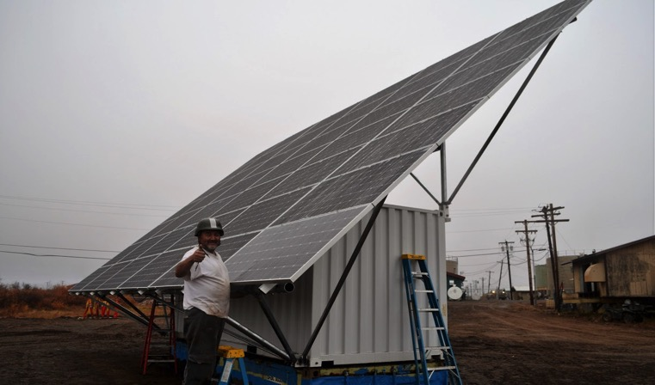
Department of Energy Solar Grant
Buckland Community Solar array is operational, but still needs performance monitoring & communication integration
Completion Dec 2019
First BoxPower installation in Alaska
Modified foundation & racking based on site-specific needs
Community training and major in-kind contributions

Slide 15
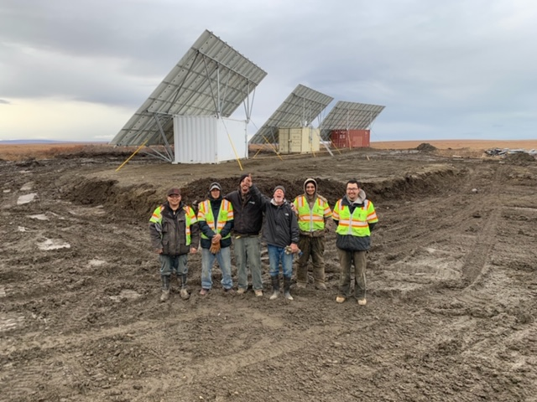
Department of Energy Solar Grant
Deering Solar Array Installation complete
Supersacks, gravel, & duckbill foundation/ anchoring - reduced costs
Single 50 kW inverter – reduced costs
Maximum local hire via Ipnatchiaq Electric, Tribe, City
Radio communication back to power plant for full system control, including curtailment

Slide 16
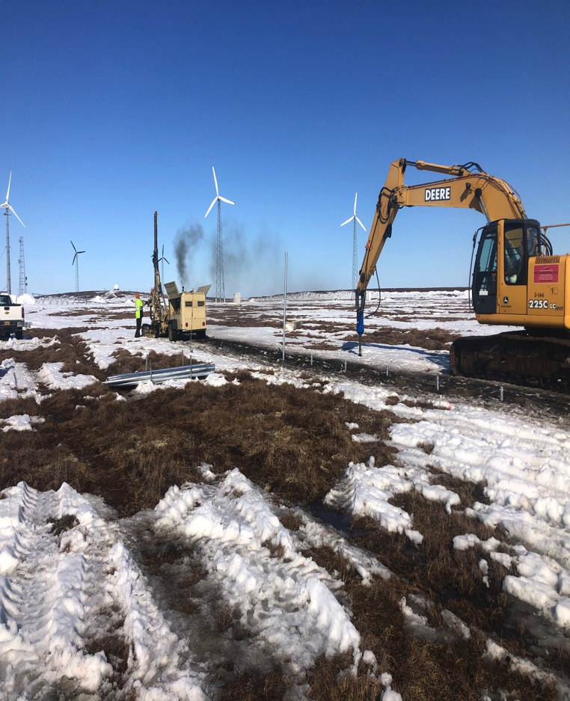
Kotzebue Solar
Alaska Native Renewable Industries selected as Kotzebue Electric Association Solar Contractor
Replaced legacy wind turbines that are no longer operational, and used some existing infrastructure to reduce costs
Largest solar array in rural Alaska (576 kW)
Interconnected with existing wind, battery, electric boilers, and now electric vehicle charging above the Arctic Circle
Drilled through permafrost for ground mounting – Improved over time, but could definitely be improved for future cost savings

Slide 17
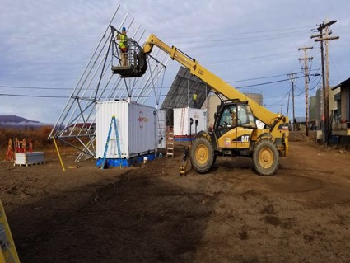
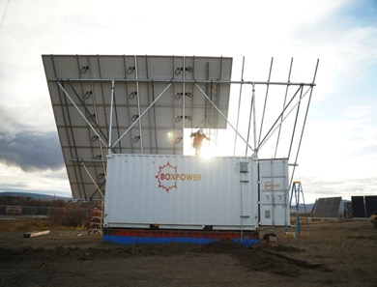
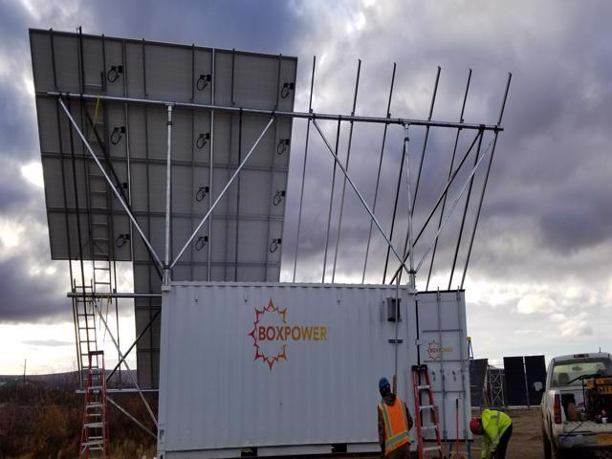
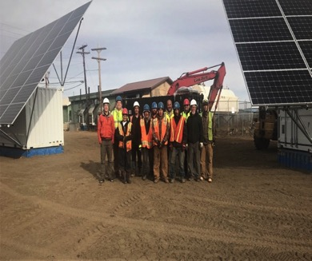
Innovations & Lessons Learned
Tilt Angle of 45 degrees = more output
Each box > 15 kW, but could be 20 kW
Low wind locations = less costly
Local Crew Works!
Trade-off between size of array and construction requirements – Each situation unique, requires analysis
Integration with batteries, wind, grid-forming inverter, electric boilers in powerhouse and waterplant – LOTS of extra work
Hosted Solar Energy International Training for region in June 2018 – created interest and competence
Continue to replicate: Noatak, elsewhere

Slide 18
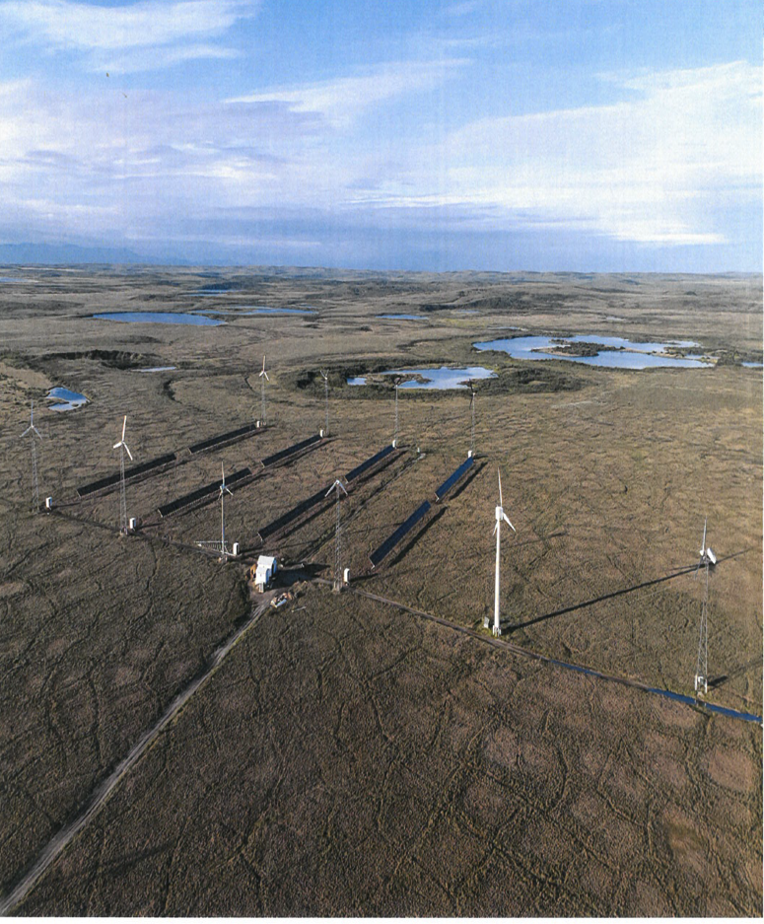
Replication in Process!
Communities of Shungnak & Kobuk interconnected via 10-mile distribution line
Received $1.3 million from USDA High Energy Cost Grant for 150 kW solar and ~650 kWh battery for Shungnak & Kobuk, plus VIF/NAB/NANA funding
Intend to create Independent Power Producer and sell power to AVEC
Partnership between Tribes and Cities of Shungnak, Kobuk, NANA, Northwest Arctic Borough

Slide 19
USDA High Energy Cost Grant
NANA selected for High Energy Cost Grant – $1.6M to install energy storage batteries and controls in Deering and Buckland
Necessary to make solar effective
ABB Control system and SAFT batteries operational in Buckland & Deering
Working with IES, ABB, Saft, KEA, DeerStone, NWAB for system integration
Allows for high penetration renewables (wind & solar) to turn diesels off when enough renewable energy available
Also controls electric boiler for additional diesel displacement

Slide 20
USDA High Energy Cost Grant –
Breaking Trail
First (and second!) utility scale wind-solar-battery-diesel hybrid system in rural AK
Diesels-off in Buckland on July 24, 2019 & in Deering on October 11, 2019
Expect Significant Fuel Savings
Developing Institutional and Financial Structures to Monetize Fuel Savings
Still Need to Address heating diesel engines and powerhouse under long-duration diesels-off (good problem to have!)
Enables high penetration & high quality renewable generation, like wind and solar energy, without destabilizing the system

Slide 21
Recommendations
Critical path to Village Economic Development: Roads and Interties
Powerhouse Upgrades to Integrate Renewable Energy
Workforce Development - Utility management, Powerhouse operators/mechanics
Renewable Energy training – wind technicians, solar technicians, energy storage battery maintenance, heat pumps

Slide 22
Leveraging Regional Lessons to Inform Policy
Grants are still necessary
Be creative to create economies of scale (e.g., Energy & Utilities can include power, heat, transportation, water, sewer, broadband; aggregate across communities & regions)
Reduce complexity of grants, cost share
Tax credits are not very useful in rural AK
Economic justification for renewables should include not just fuel savings, but also jobs, energy security, fuel diversity, reduced impact on diesel equipment
Workforce development is crucial for long term project success (and often neglected, with limited funding opportunities)
Provide long term funding & technical support – not annual cycles

Slide 23
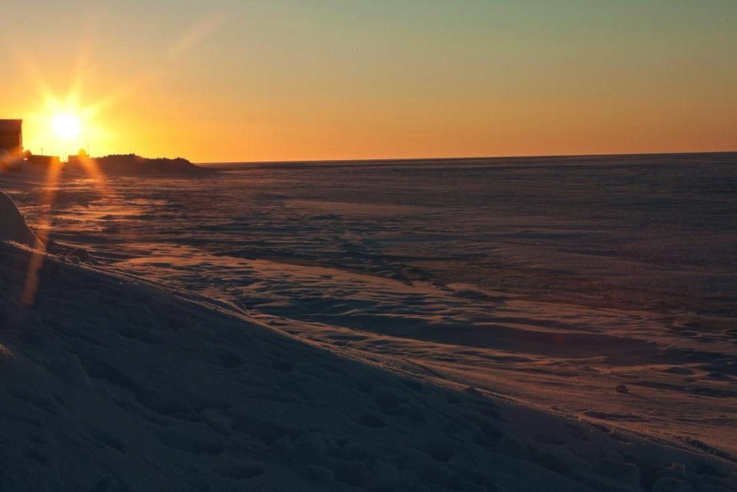
Sonny Adams
Director of Alternative Energy
NANA Regional Corporation
Sonny.adams@nana.com
(907) 265-4185
Taikuu!
Brian Hirsch
Founder & CEO
DeerStone Consulting
brian@deerstoneconsulting.com
(907) 299-0268

